Slide 1
Step 1
Click on VM icon

Slide 2
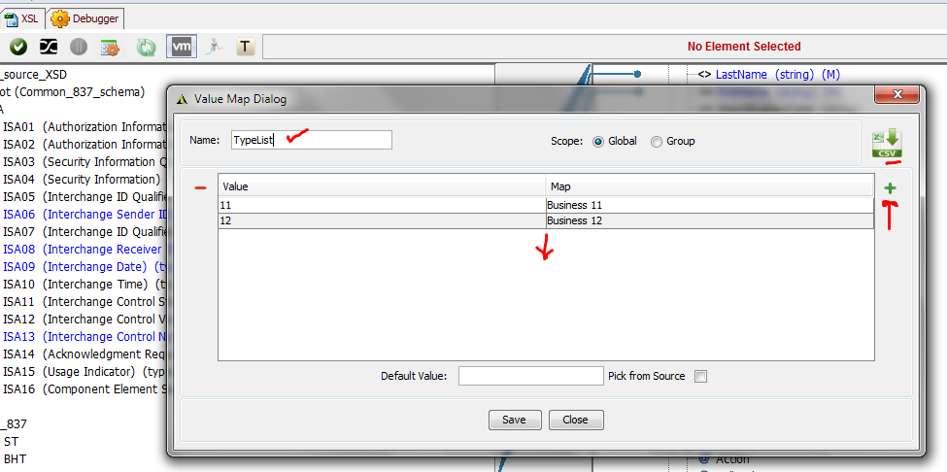
Step 2
Type in Value Map name such as Typelist and then enter the
Values of Source and your expected values in the Map column.
Click + sign to add more value map pairs
The csv option is to upload a predefined file. And click Save on this window.

Slide 3
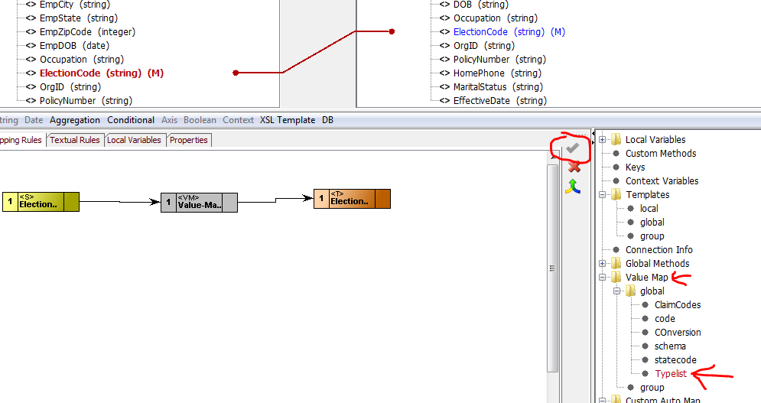
How to use this Value Map?
Value map after Save will appear in the bottom right tree under Value Map category.
Select your target field by clicking on it and then double click on your Value Map name.
It will show the grey box in the canvas. Now double click on the Source field (appears in yellow)
Now from the right side of the Source field do a click and drag and map to the left side of the
Value Map function. And then from the right side of the Value Map to the target element.
Click on check mark to save the mapping.

