Slide 2
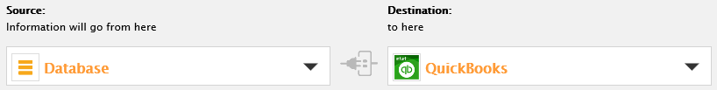
Data Interface Tutorial
Example: Extract Customer Accounts data from a Database and load it into QuickBooks

Slide 3
QuickBooks Database Info Server URL Steps
Obtain Company ID
Create App/Obtain App Token
Obtain OAuth credentials

Slide 4
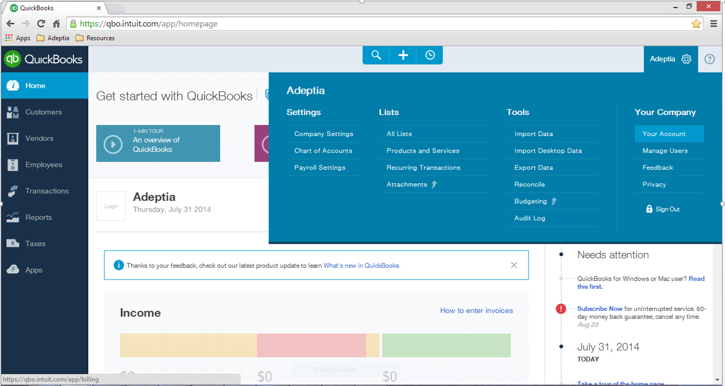
1 – Obtain Company ID
1
2

Slide 5
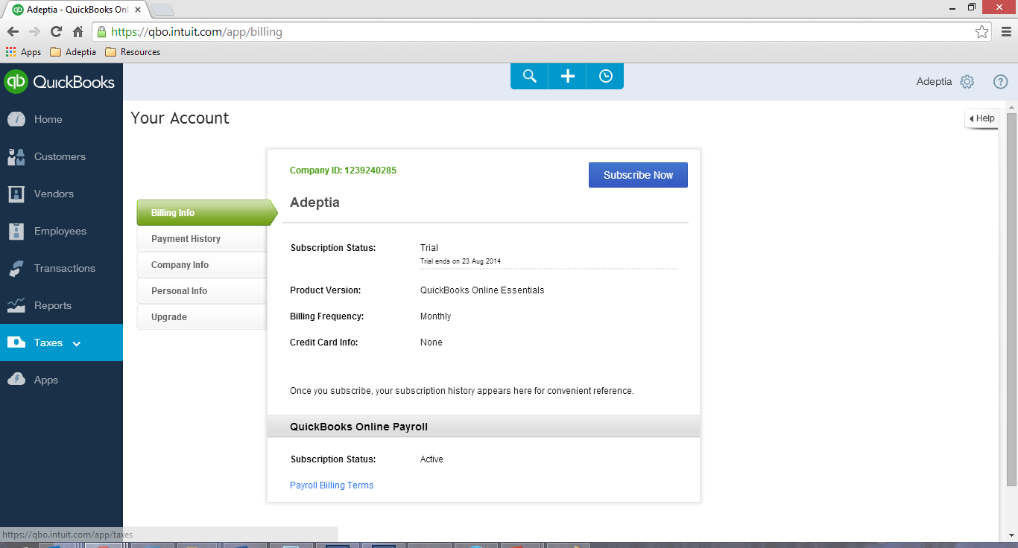
1 cont. – Obtain Company ID
3

Slide 6
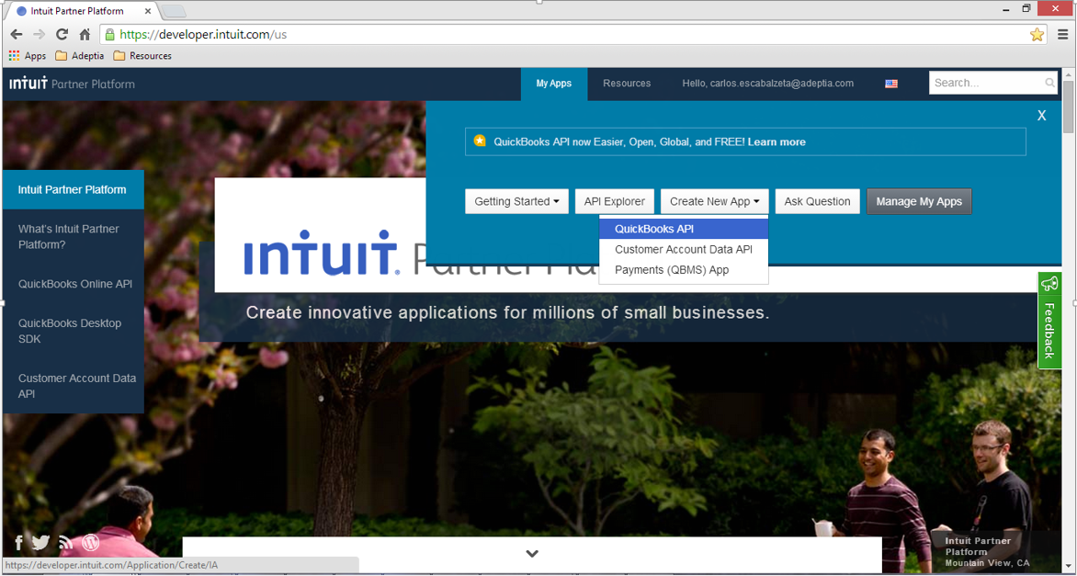
2 – Create App/Obtain App Token
1
2
3

Slide 7
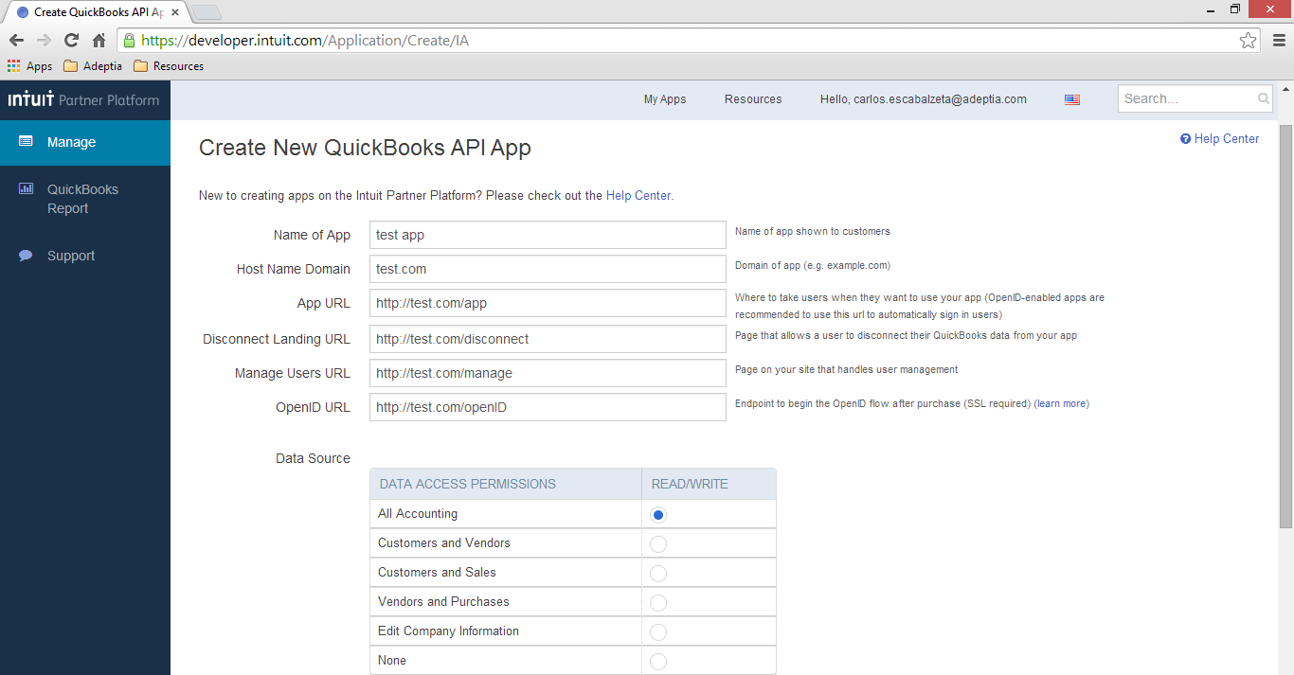
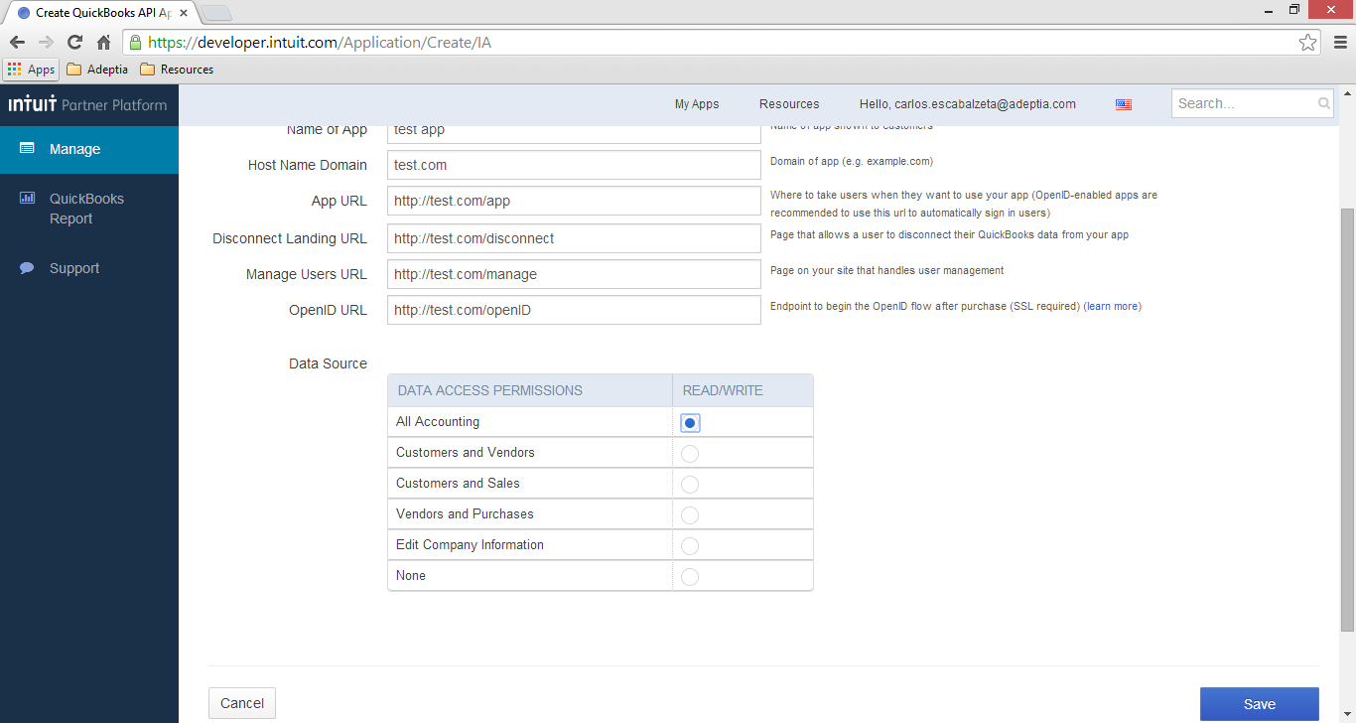
2 cont. – Create App/Obtain App Token
4
5

Slide 8
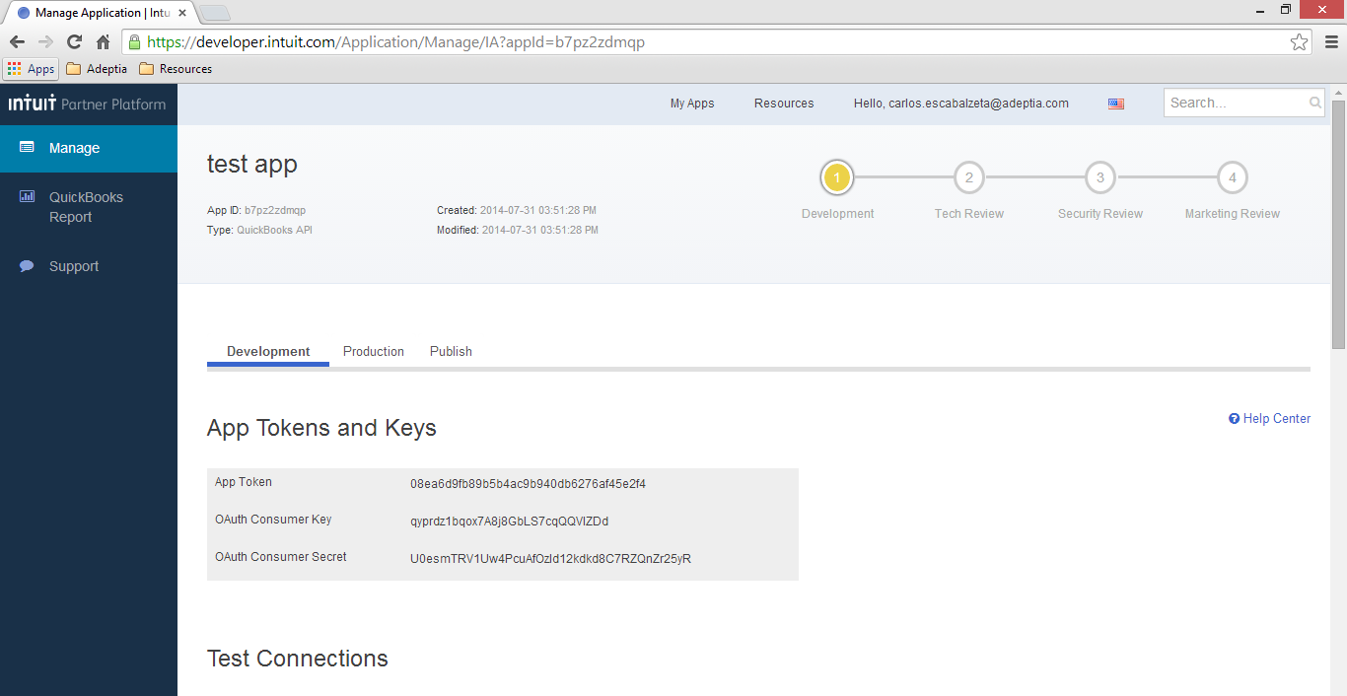
2 cont. – Create App/Obtain App Token
6

Slide 9
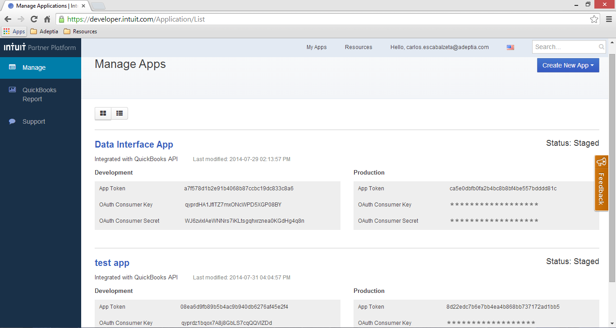
2 cont. – Create App/Obtain App Token

Slide 10
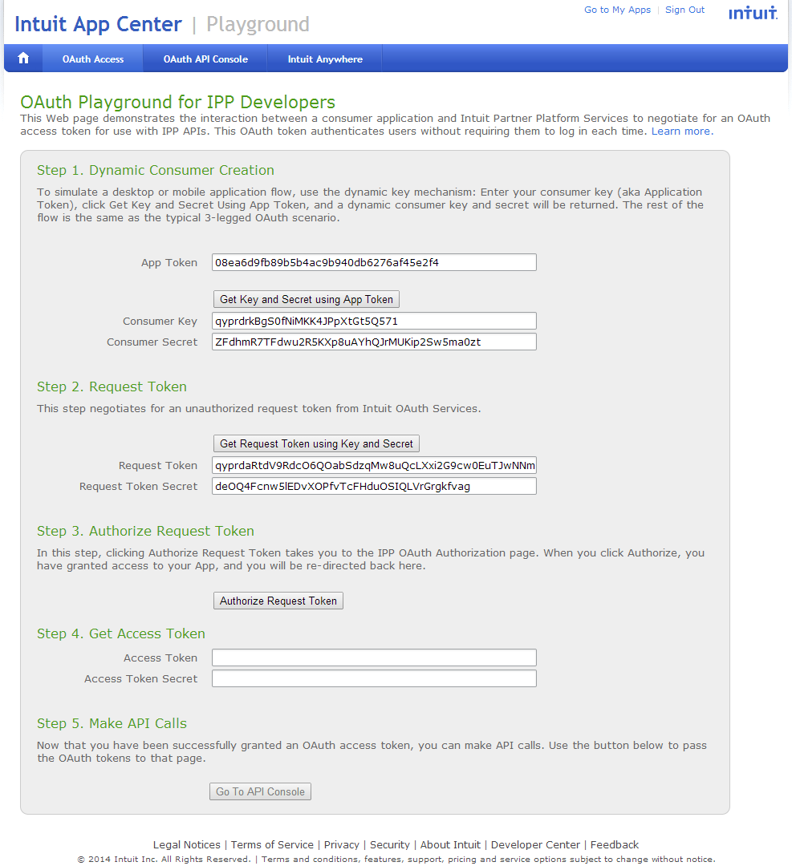
3 – Obtain OAuth credentials
1
2
3
4

Slide 11
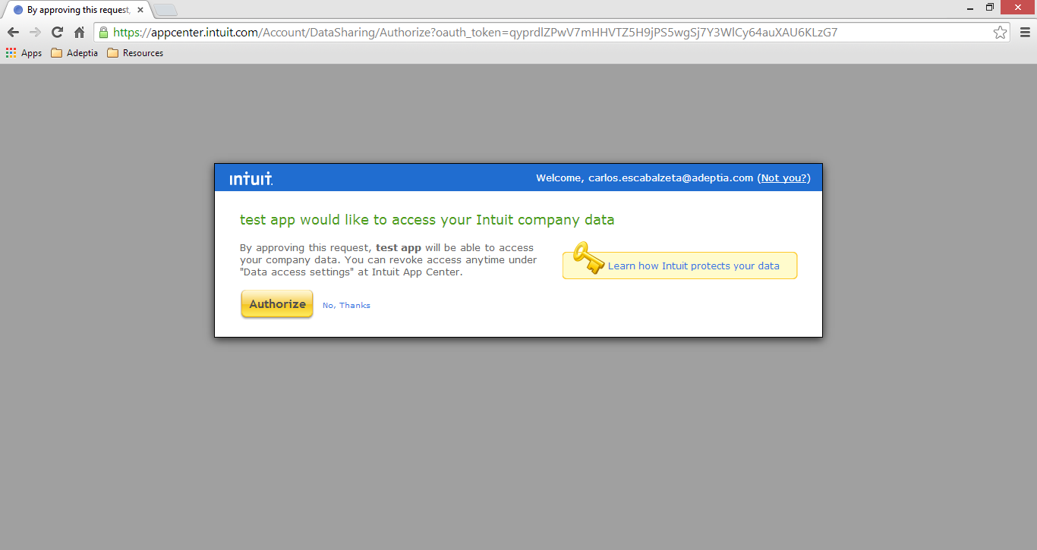
3 cont. – Obtain OAuth credentials
5

Slide 12
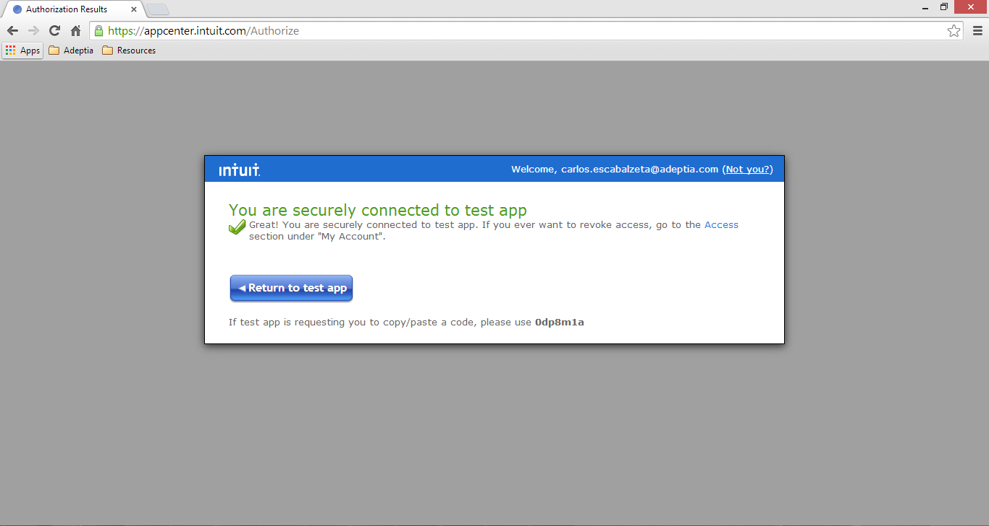
3 cont. – Obtain OAuth credentials
6

Slide 13
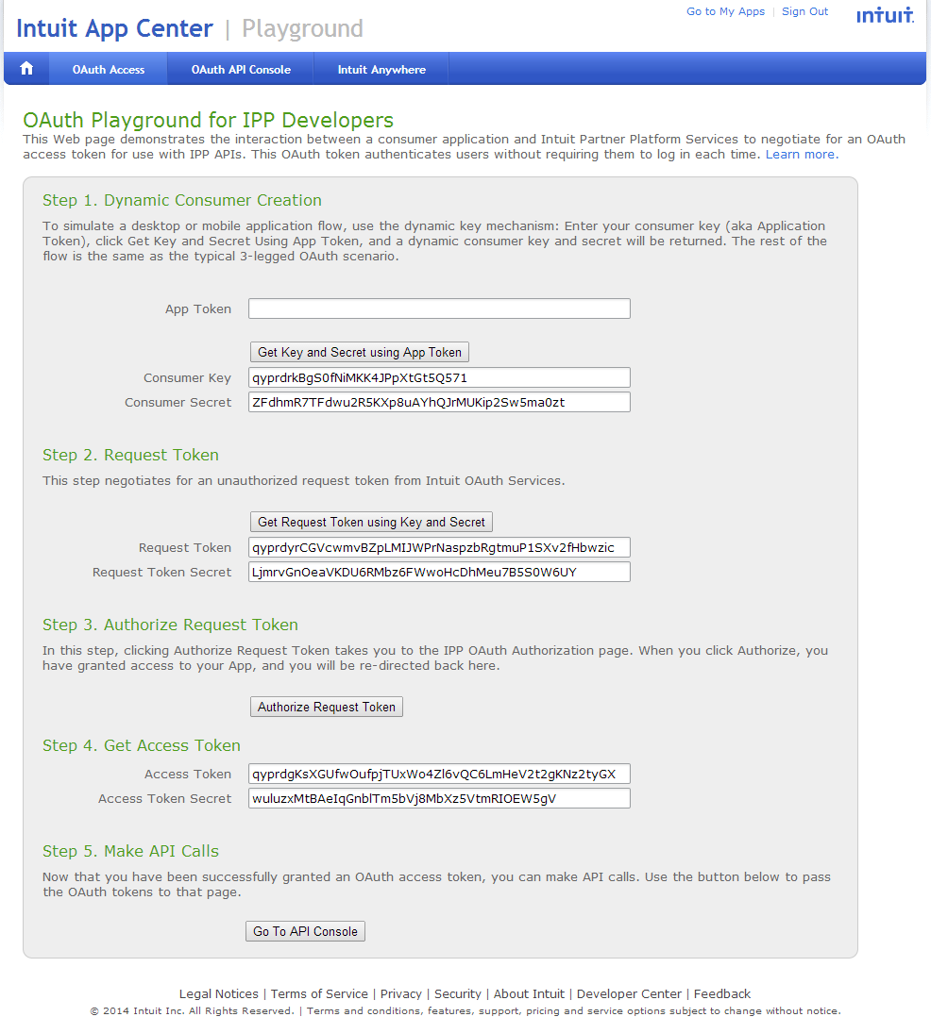
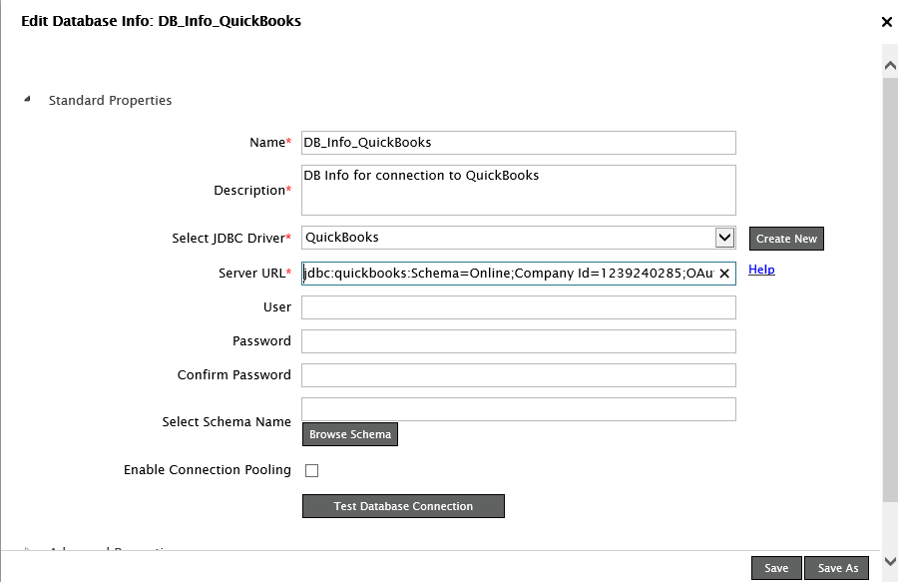
3 cont. – Obtain OAuth credentials
Adeptia’s Database Info Server URL should be all on one line such as below
jdbc:quickbooks:Schema=Online;Company Id=1239240285;OAuth Client Secret=ZFdhmR7TFdwu2R5KXp8uAYhQJrMUKip2Sw5ma0zt;OAuth Client ID=qyprdrkBgS0fNiMKK4JPpXtGt5Q571;OAuth Access Token=qyprdgKsXGUfwOufpjTUxWo4Zl6vQC6LmHeV2t2gKNz2tyGX;OAuth Access Token Secret=wuluzxMtBAeIqGnblTm5bVj8MbXz5VtmRIOEW5gV;
7
Here the Server URL is broken out so you can see what needs to be matched up from the Intuit App Center Playground to the appropriate Server URL fields:
jdbc:quickbooks:Schema=Online;Company Id=1239240285;
OAuth Client Secret=ZFdhmR7TFdwu2R5KXp8uAYhQJrMUKip2Sw5ma0zt;
OAuth Client ID=qyprdrkBgS0fNiMKK4JPpXtGt5Q571;
OAuth Access Token=qyprdgKsXGUfwOufpjTUxWo4Zl6vQC6LmHeV2t2gKNz2tyGX;
OAuth Access Token Secret=wuluzxMtBAeIqGnblTm5bVj8MbXz5VtmRIOEW5gV;

Slide 14
Thank You!
For additional information, please contact: support@adeptia.com

