Slide 1
  Process flow for rate limit

Slide 2
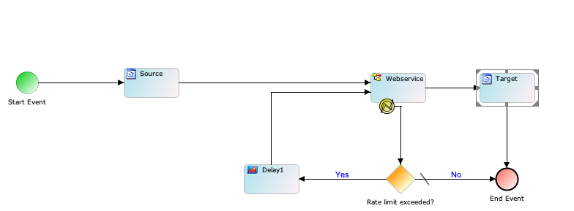
Process flow example

Slide 3
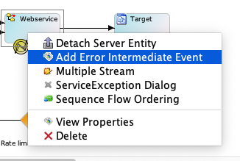
STEPS
Add an “intermediate error event” on web service activity by right-click the activity and click on “intermediate error event”
Click on the web service activity and go to OnException scripts tag and add following Service Exception script:
context.put("exception_message",exception.getMessage())
Add following script in Gateway condition:

Slide 4
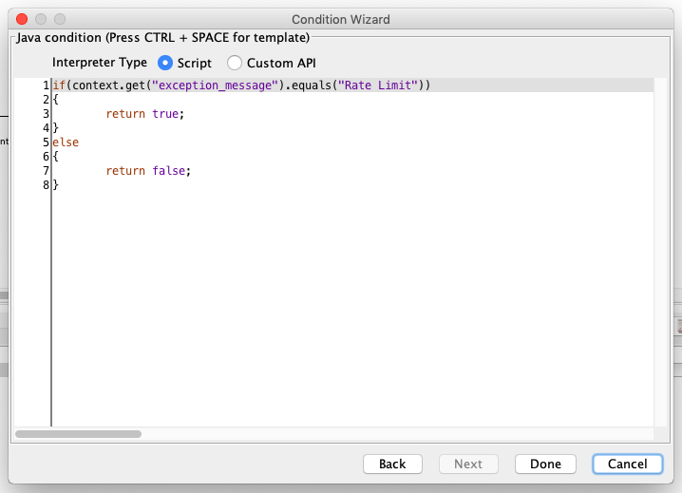
Note: in the above script change the “Rate Limit” to the actual Rate Limit
error message returned by Webservice

